Slide 1
Process Live Migration
using
Git based
Incremental Checkpointing
Arun Bharadwaj
Praveen Keshavamurthy

Slide 2
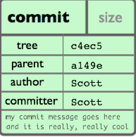
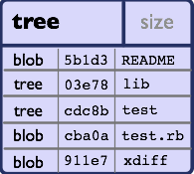
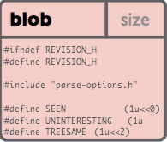
Git Object Model

Slide 3
Architecture
Git Server
Hook
Machine - 2
Machine - 1
Local Git
Repo
Live Migration Service
Http End Points
Process - 1
/sync/init
/sync/restart
Process - 1
Local Git
Repo

Slide 4
Issues
Pending Tasks
Any access to stack variables will result in SEGV
Handling of removal of memory segment from the git repo
Measure the efficiency of the Git diff objects

